Slide 1
Colorado Restaurant Assistant
Danielle Fleig, Nathan Garcia, Brian Kimbrell, Rikki Cook, Dr. Snyder
Notes:
Your goal should be to create good analysis and documentation of your project and process so others can visit the GitHub Organization and be inspired.

Slide 2
70+% of Founded Colorado Restaurants have failed since 1903!
ANALYTICS
There are several quantifiable metrics which can be used to measure restaurant success. These metrics include personal income, average wages, population, county average earnings and employment.
As an owner or a potentially owner of a restaurant, this data would be helpful in determining which locations which would be more suitable for a new enterprise.
These finding would also benefit investors in making data-driven decisions.

Slide 3
Business Decision Maker
ANALYTICS
The target audience for this project is for entrepreneurs seeking to enter the Colorado food service industry.
This analysis would also help benefit State Agencies such as the Grand Junction Economic Partnership, investors and banks who are interesting in investing in the food service industry.

Slide 4
Competition and Existing Alternatives
ANALYTICS
Our product will quantify success metrics for restaurants.
It would help entrepreneurs determine the timeline and location they should select for the optimal success.
Yes, there are existing sites that use Yelp review data to determine success of restaurant. Those sites can potentially use the metric we used, and we could benefit from using Yelp’s data.

Slide 5
Impact
ANALYTICS
It gives Business Decision Makers the tools to determine if they should open a restaurant as well as factors which help them determine the feasibility of the enterprise.
Restaurants fail at a rate of 10% higher than other businesses as a whole in Colorado.

Slide 6
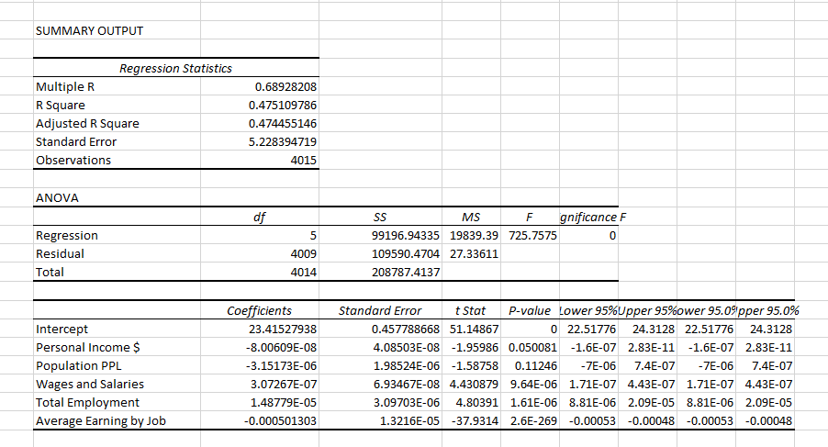
Implementation
ANALYTICS
This analysis illustrates several use factors in determining business success an longevity. Business could use this data to be more successful entrepreneurs.
Yelp ratings and review data, GDP, Crime
Our coefficient of determination is 47.5%.

Slide 7
Datasets
Our team excised useless data, geocoded and cross-referenced the remainder.

Slide 8
Data
ANALYTICS
The results show a relation between several economic factors and business success and longevity. By compiling this with restaurant specific data such as Yelp, We believe the R^2 value can be further increased. Furthermore, evaluation for non-linearity may also increase the accuracy of the analysis.

